Slide 1


Eco-Latte
CTO: Venus, CFO: Vanessa, and CEO: Bianca

Slide 2
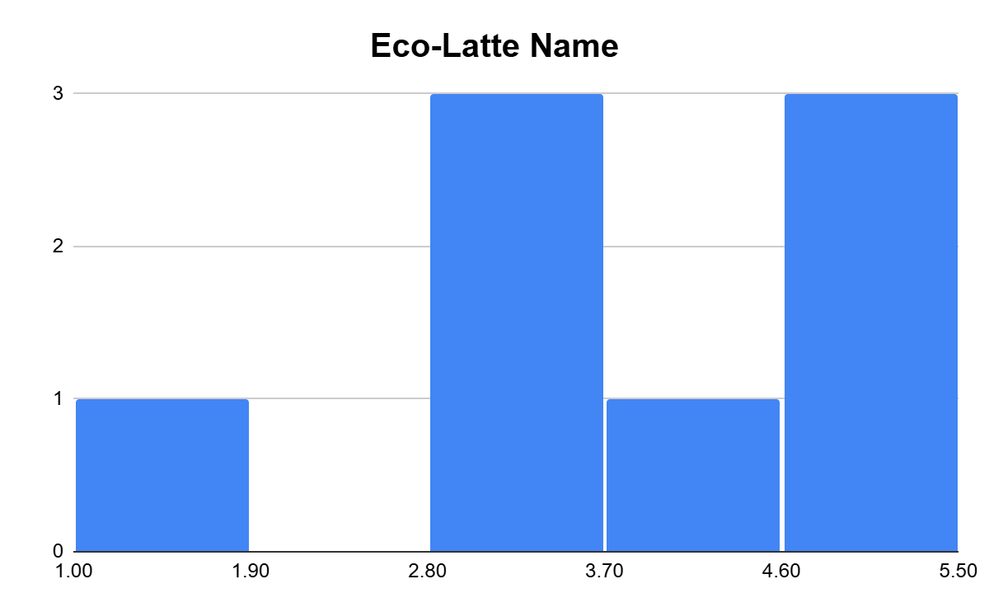
We asked what people thought of the name Eco-Latte. Most people felt positive about the name, with 1 person disliking it. This name was received better than RegenCafe.

Slide 3
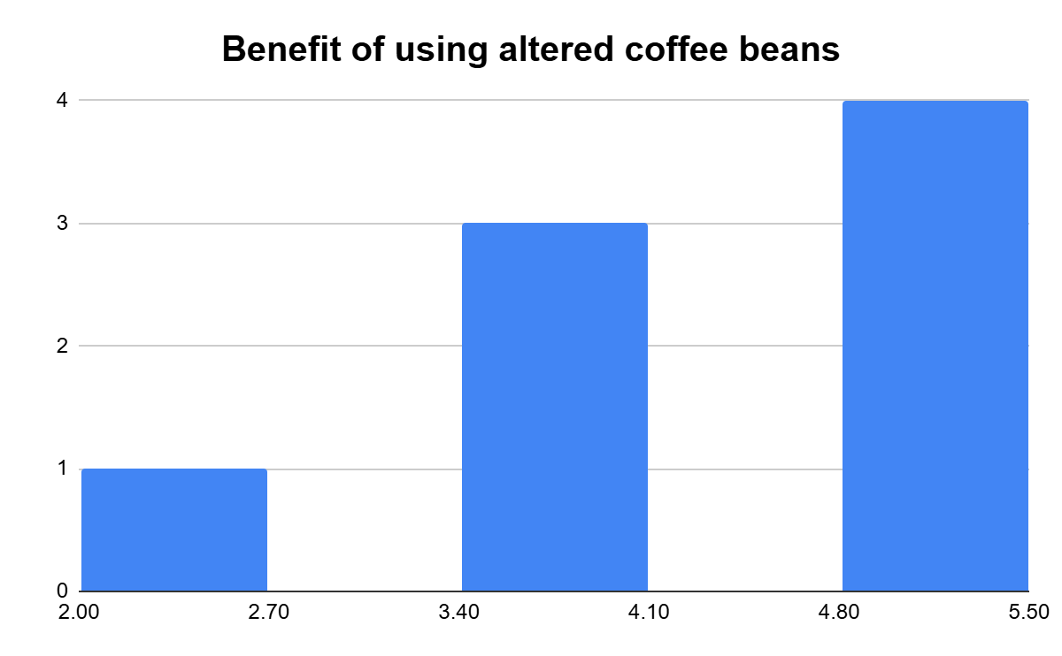
We asked people if they owned a coffee shop, would they benefit from using altered coffee beans. Most people said they would, and 1 person said they wouldn’t. Changing the way we worded this question was received better than last time as well.

Slide 4
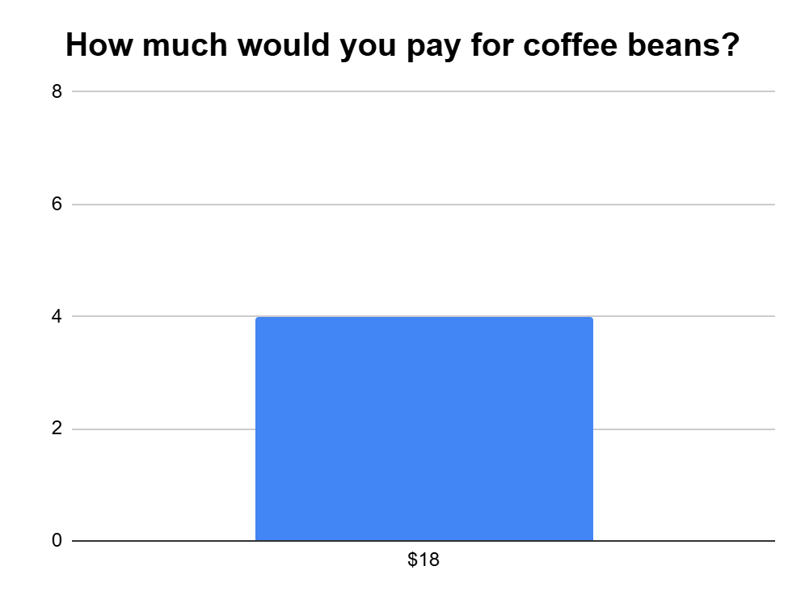
We gave people the option of $12, $18, and $25 for a pound of coffee beans giving them context that a pound of coffee beans costs a coffee shop between $7-22. We gave an extra option of “I don’t have much preference for how much it would cost, as long as I still make a profit” which most people chose. The only number that was chosen was $18, so we will keep our price point around there.

Slide 5
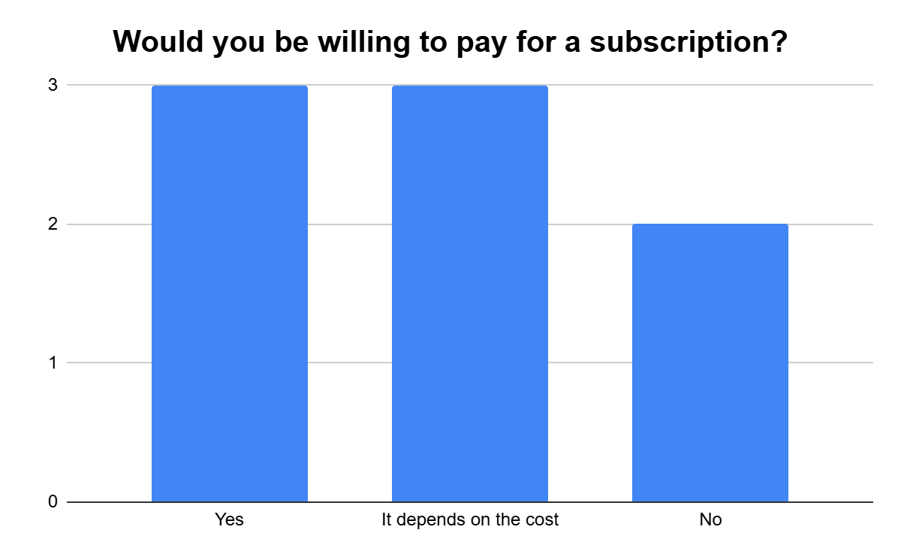
Lastly, we asked people if they would be willing to pay for a subscription service. Most people said yes, or it depends on the cost. A couple people said no.

